Slide 1
CompSci 190: Lecture 15: Bias
Jeff Forbes
December 5, 2018

Slide 2
Decisions Under Uncertainty
Interpretation by Physicians of Clinical Laboratory Results (1978)
"We asked 20 house officers, 20 fourth-year medical students and 20 attending physicians, selected in 67 consecutive hallway encounters at four Harvard Medical School teaching hospitals, the following question:
"If a test to detect a disease whose prevalence is 1/1000 has a false positive rate of 5%, what is the chance that a person found to have a positive result actually has the disease, assuming that you know nothing about the person's symptoms or signs?"

Slide 3
Decisions Under Uncertainty
Interpretation by Physicians of Clinical Laboratory Results (1978)
"Eleven of 60 participants, or 18%, gave the correct answer. These participants included four of 20 fourth-year students, three of 20 residents in internal medicine and four of 20 attending physicians. The most common answer, given by 27, was that [the chance that a person found to have a positive result actually has the disease] was 95%.

Slide 4
Round One
Scenario:
Class consists of second years (60%) and third years (40%)
50% of the second years have declared their major
80% of the third years have declared their major
I pick one student at random.
Which is more likely: Second year or third year?
Second year, because they are 60% of the class

Slide 5
Round Two
Slightly different scenario:
Class consists of second years (60%) and third years (40%)
50% of the second years have declared their major
80% of the third years have declared their major
I pick one student at random... That student has declared a major!
Second Year or Third Year?
(Demo)

Slide 6
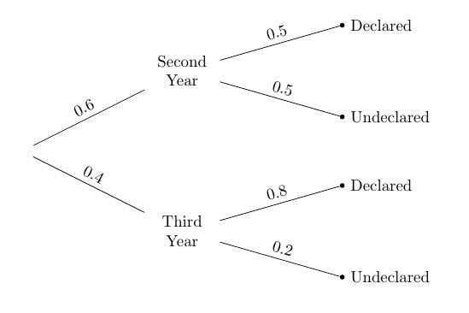
Terminology
Prior probability
Likelihood
Likelihood
Prior probability

Slide 7
Bayes’ Rule
Posterior probability:
P(Third Year | Declared)
0.4 x 0.8
= ----------------------------------
(0.6 x 0.5) + (0.4 x 0.8)
= 0.5161…
Pick a student at random.

Slide 8
Purpose of Bayes’ Rule
Update your prediction based on new information
In a multi-stage experiment, find the chance of an event at an earlier stage, given the result of a later stage
(Demo)

Slide 9
Example: Doctors & Clinical Tests
Out of 1000 patients:
So only 1 / 50.95 of patients with positive test results have the disease.
 | Positive test result | Negative test result
Has disease | 1 | 0
Doesn't have disease | 49.95 | 949.05

Slide 10
Using Data Science in Society
What’s an algorithm?
What are the advantages?
Efficient
Objective
Expanding access
What are the risks?
Data used as input
The algorithm itself

Slide 11
Challenge 1: Inputs to an Algorithm
Consider trying to generate fastest route to a destination (e.g., Google Maps). Problems include:
Poorly selected data
Incomplete, incorrect, or outdated data
Selection Bias
Unintentional perpetuation and promotion of historical biases

Slide 12
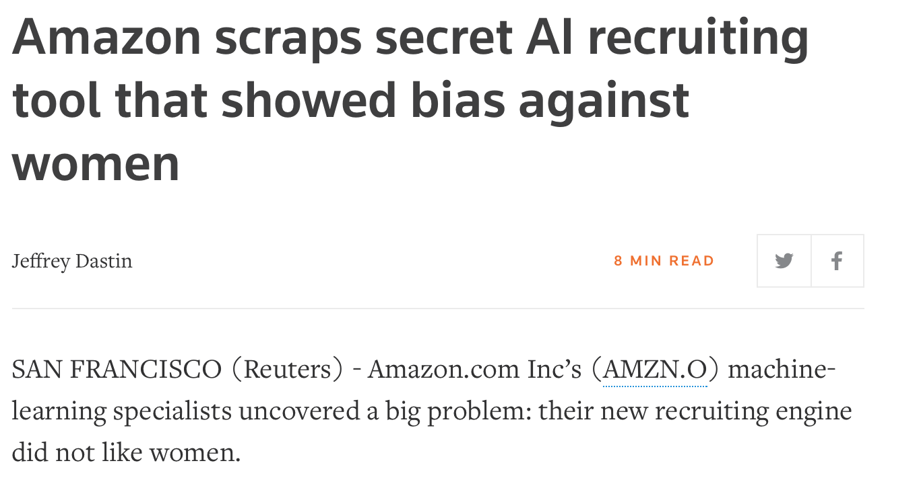
Resumé screening

Slide 13
Predictive policing

Slide 14
Challenge 2: The algorithm itself
Poorly designed matching systems
Personalization that narrow rather than expand user options
Correlation does not imply causation!
Beware of black boxes!

Slide 15
Sentencing software
Correctional Offender Management Profiling for Alternative Sanctions
Predict the likelihood of recidivism

Slide 16
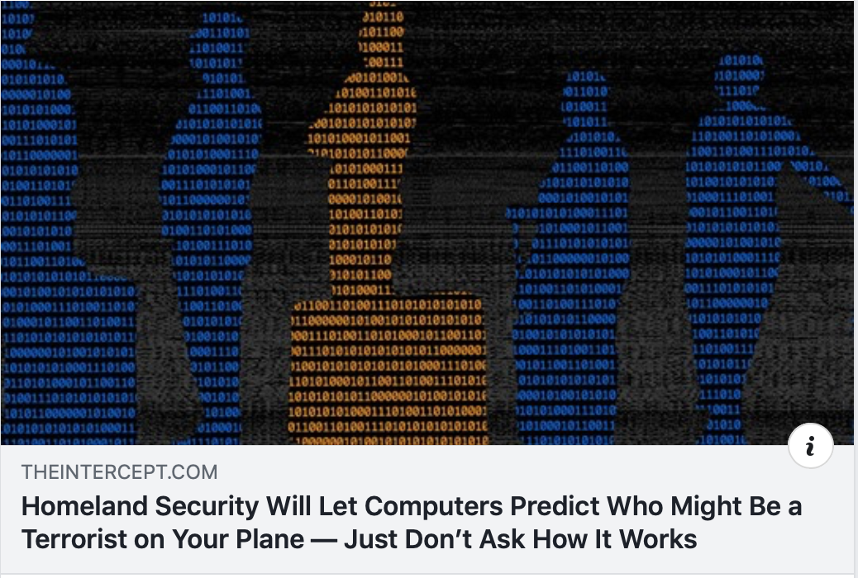
Homeland Security?

Slide 17
What’s left?
Grades
Labs & HW graded primarily by completion
Projects graded for correctness
Summary posted by end of the day on December 15
Final Project
Submit notebook, presentation, and documents by noon, December 16
Presentations (< 10 minutes) – 2pm on December 16
Motivating questions
Methods to answer those questions
Visualizations of key results
Conclusions

Slide 18
Thank you!
Please complete course evaluation on DukeHub
Complete teammate evaluation (link will be posted on Sakai)

